Slide 1

Academic Writing Course

Slide 2
Objectives
To learn how to formulate a research question;
To learn how to cite other people's previous work;
To try to be critical and relevant in your reviewing;
To avoid plagiarism.

Slide 3
Contents
1
General Format of Research Paper
2
Definition of Literature Review
3
Steps in Reviewing Literature
4
Elements in Introduction Section
5
Organization of Literature Review
6
Ways to avoid plagiarism

Slide 4
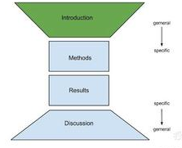
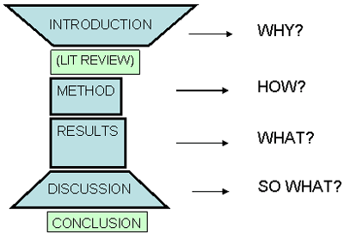
General Format of Research Paper
IMRaD format
Introduction
Why research needed
Methodology
How research completed and results analyzed
Results And
What was found (data)
Discussion
Interpretation of results and application to clinical practice

Slide 5

What is a literature review?
A literature review is a text of a scholarly paper, which includes the current knowledge including substantive findings, as well as theoretical and methodological contributions to a particular topic. Literature reviews use secondary sources, and do not report new or original experimental work
http://en.wikipedia.org/wiki/Literature_review
The focus of a literature review is to summarize and synthesize the arguments and ideas of others without adding new contributions.

Slide 6
Discussion
Steps to conduct a literature review
Step 1
Step 2
Step 3
Step 4
Step 5
Defining the purpose
Searching for the literature
Reading and analyzing the literature
Organizing the contents
Writing the review
Journal papers
Books
Theses and dissertations
Conference proceedings
Government publications
Technical reports
Internet resources

Slide 7


P26
What are included in Introduction?
Elements |  | Functions
Para. 1 S1-2
Para. 1 S3-5
Para. 2-3
Para. 4
Para. 5
General Statements
to provide the reader with a setting for the problem to be investigated
Specific Statements
to describe the aspects of the problem already studied by other researchers
(Literature Review)
to find the gap and indicate the need for more investigation of the problem
Thesis Statement
to present the purposes/objectives of the current study
Optional Statements
to give a value or justification for carrying out the study, limitation of the study, etc.

Slide 8

List different opinions on poverty and environmental degradation
Bruntland Commission Report, etc. on the one side | Leach and Mearns on the other side
Poverty is a major cause of environmental problems and amelioration of poverty is a necessary and central condition of any effective programs addressing the environment.
Environmental degradation, rapid population growth and stagnant production are closely linked with the fast spread of acute poverty in many countries of Asia.
Poor families who have to meet short term needs mine the natural capital by excessive cutting of trees for firewood and failure to replace soil nutrients.
These studies point to demographic, cultural, and institutional factors as important variables in the poverty-environmental degradation nexus.
An intricate web of factors plus the existence of feedback loops from environmental degradation to poverty makes the process of identifying causality links, if any, between environmental degradation and poverty a difficult exercise.

Slide 9
Organization of Literature Review
Chronological
  By publication date
  By trend
Thematic
  A structure which considers different themes
Methodological
  Focuses on the methods of the researcher, e.g., qualitative versus quantitative approaches

Slide 10
some of the questions a literature review should answer
What do we already know in the immediate area concerned? What are the characteristics of the key concepts or the main factors or variables? What are the relationships between these key concepts, factors or variables? What are the existing theories? Where are the inconsistencies or other shortcomings in our knowledge and understanding? What views need to be (further) tested? What evidence is lacking, inconclusive, contradictory or too limited? Why study (further) the research problem? What contribution can the present study be expected to make? What research designs or methods seem unsatisfactory?

Slide 11
P35
Read, Think and Answer
Literature Review
Until recently many researchers have shown interest in the field of coastal erosion and the resulting beach profiles. They have carried out numerous laboratory experiments and field observations to illuminate the darkness of this field. Their findings and suggestions are reviewed here.
JACHOWSKI (1964) developed a model investigation conducted on the interlocking precast concrete block seawall. After a result of a survey of damages caused by the severe storm along the coast of USA, a new and especially shaped concrete block was developed for use in shore protection. This block was designed to be used in a revetment type seawall that would be both durable and economical as well as reduce wave run-up and overtopping, and scour at its base or toe. It was proved that effective shore protection could be designed utilising these units.
HOM-MA and HORIKAWA (1964) studied wave forces acting on the seawall which was located inside the surf zone. On the basis of the experimental results conducted to measure wave forces against a vertical wall, the authors proposed an empirical formula of wave pressure distribution on a seawall. The computed results obtained by using the above formula were compared well with the field data of wave pressure on a vertical wall.
SELEZOV and ZHELEZNYAK (1965) conducted experiments on scour of sea bottom in front of harbour seawalls, basing on the theoretical investigation of solitary wave interaction with a vertical wall using a Boussinesque type equation. It showed that the numerical results were in reasonable agreement with laboratory experimental data.

Slide 12
4. Is it a good literature review? Why?
We don't believe that it is a good literature review. It only gives a summary of previous research; it does not use the literature to explain more about the writer's own research problem. Also, it is not critical: after we read it we still do not know which theories or findings are important, which are inconclusive and what the shortcomings are.
The main problem with this literature review is that it does not show how previous research relates to the writer's own research problem, or the relationship between different research already carried out. Given the organisation the writer has used, this literature review could not be effective because there is little scope for showing relationships, drawing comparisons or making evaluations.

Slide 13
1. Which of the questions does this literature review answer?
This literature offers a summary of previous research, so it does answer the first question. It simply tells the reader what was discovered in previous research.
2. Which of them doesn't it answer?
This literature review doesn't answer any of the questions from 2 to 10. It doesn't evaluate the research it summarises, nor does it show the relationships between the different theories, views and approaches it describes.
3. Which method has the writer used to organise the literature review?
The writer has organised this literature review around the researchers and has presented it chronologically (arranging the work by when it was published). Notice that by organising it around the researchers (the summaries are listed after the names of the people who did the research) and not around the research (around key concepts) the writer emphasises the people and not their work.

Slide 14
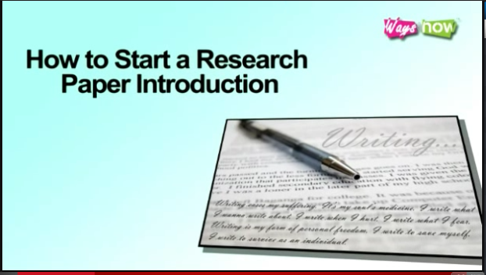
Tips for Writing an Introduction

Slide 15



How to avoid plagiarism?
acknowledge
attribute
cite
reference
give credit to
acknowledgement
attribution
citation
your sources of information

Slide 16
Why to cite?
To give credit to another author for his/her ideas
To show that you have researched your topic, that you understand the concepts and know who has written about them
To allow your reader to find and examine your sources

Slide 17






Styles of citation?
the social and behavioural sciences
the humanities, especially language and literature
Institute of Electrical and Electronics Engineers
Business, History, and the Fine Arts
Notes:
http://academic.evergreen.edu/curricular/stilllooking/reference/Citation%20Guides/introduction.htm

Slide 18

P33
How to cite?
Internal/In-text/parenthetical citation
1. Information prominent
Shrinking markets are also evident in other areas. The wool industry is experiencing difficulties related to falling demand worldwide since the development of high-quality synthetic fibres (Smith, 2000).
2. Author prominent
Shrinking markets are also evident in other areas. As Smith (2000) argued that the wool industry was experiencing difficulties related to falling demand worldwide since the development of high-quality synthetic fibres. However, Jones et al. (2004) found that industry difficulties were more related to quality of supply than to demand issues. It is clear that considerable disagreement exists about the underlying sources of these problems.
3. Weak author prominent
Several authors have reported that the wool industry is experiencing difficulties related to falling demand since the development of highquality synthetic fibres (Nguyen, 2005; Smith, 2000; Wilson, 2003).

Slide 19
Practice 1
Read and decide which citation method is used. And then change the citation method
1. Close (1983) developed a simplified theory using an analogy between heat and mass transfer and the equivalent heat transfer only case.
A simplified theory has been developed using an analogy between heat and mass transfer and the equivalent heat transfer only case (Close, 1983).
author-prominent
2. For viscoelastic fluids, the behaviour of the time-dependent stresses in the transient shear flows is also very important (Boger et al., 1974).
Boger et al (1974) claim that for viscoelastic fluids, the behaviour of the time-dependent stresses in the transient shear flows is also very important.
information prominent
3. It has been suggested by several authors that automated testing should be more readily accepted (Balcer, 1989; Stahl, 1989; Carver and Tai, 1991).
It has been suggested that automated testing should be more readily accepted (Balcer, 1989; Stahl, 1989; Carver and Tai, 1991).
weak author-prominent

Slide 20
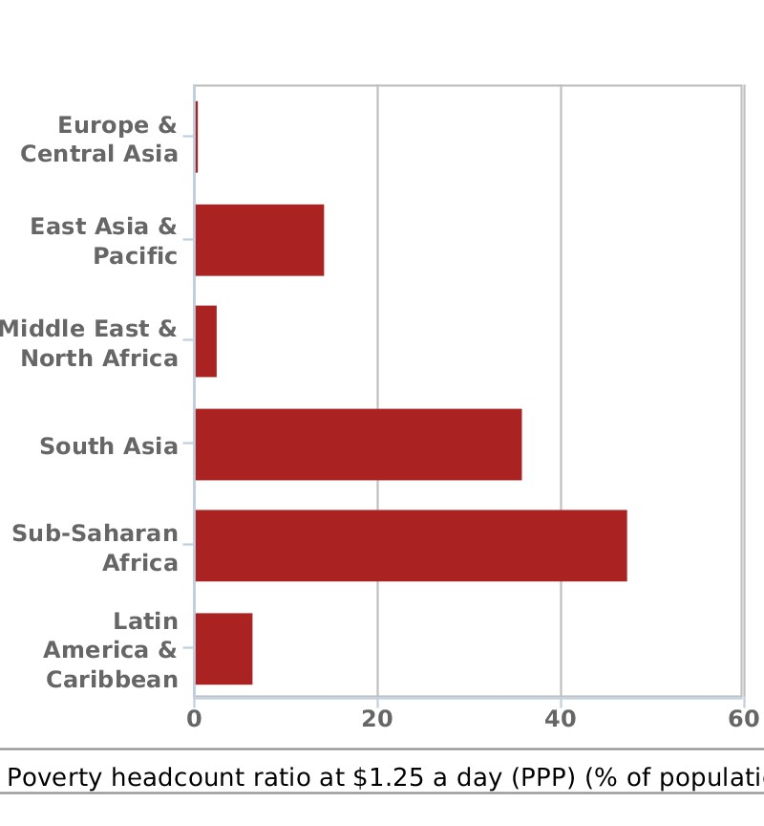
P34
Practice 2
The following is a chart describing people living on less than 1.25 dollars. Look at the chart and practice citing these figures by using three different types of citation.
Figure: Poverty headcount ratio at $1.25 a day (% of population)
Created By Swati Revankar from World Bank, 2012

Slide 21
Key for Reference
Information prominent citation
Among the six areas regarding the poverty headcount ratio at $1.25 a day, sub-Saharan Africa constituted the biggest ratio up to almost 50% of the population. (World Bank, 2012)
Author prominent citation
The World Bank (2012) stated that South Asia ranked the second in the chart regarding poverty ratio at $1.25 a day among six areas in the world.
As a report from the World Bank (2012) indicated, the top two areas of poverty headcount ratio at $1.25 a day were sub-Saharan Africa and South Asia, with a population of almost 50 percent and 37 percent respectively.
Weak author prominent citation
As a report from an authority indicated, the top two areas of poverty headcount ratio at $1.25 a day were sub-Saharan Africa and South Asia, with a population of almost 50 percent and 37 percent respectively. (World Bank, 2012)

Slide 22
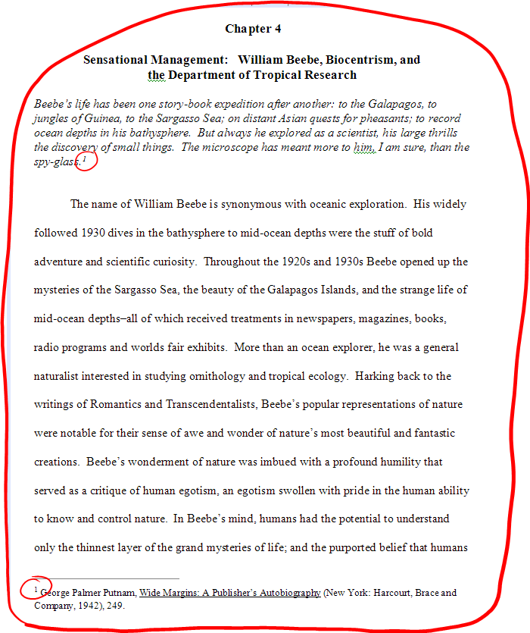
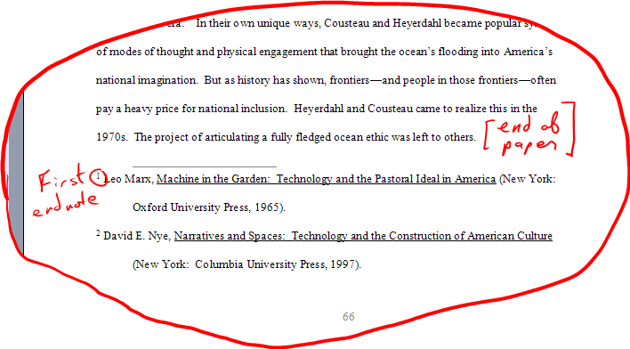
How to cite?
Footnote/endnote
http://www.philteach.net/OnFootnotes.html

Slide 23



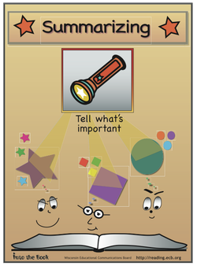

Strategies for avoiding plagiarism?
put quotation marks around the words and identify the source.
put the information into your own words and identify the source.
take the key ideas and paraphrase them and identify the source
Notes:
http://integrity.mit.edu/academic-writing/incorporating-words-and-ideas-others

Slide 24

Tenses in citation?
Tense | Function
Simple Present | To cite others’ opinions or research, or to lead to their own ideas, theories, concepts, methods, etc.
Simple Past | To provide particulars for recounting previous events or results, or a preceding generalization or the basis for a claim, etc.
Present Perfect | To state that the research results are new, expressing what has been found over an extended period in the past and up to the present to highlight the direct relations between previous studies and the author’s current research.

Slide 25
Check 1.2 reading passage and complete the following table
Questions | Answers | Purposes
Are there sentences written in the simple present tense?
Are there sentences written in the simple past tense?
Are there sentences written in the present perfect tense?
Which tense is used the most? Why?
To show the author’s opinions on others’ research, and to relate what they say or discuss to the current research.
Yes, there are many.
Yes, there are some.
To emphasize previous research findings or results.
To state that the research results are new, expressing what has been found over an extended period in the past and up to the present to highlight the direct relations between previous studies and the author’s current research.
Yes, there are some.
The simple present tense
To emphasize the significance of the present study.

Slide 26
Reporting verbs?
Advanced ways to show your attitude
Positive attitude | Neutral attitude | Negative attitude
acknowledges affirms analyzes applauds argues contends explains identifies observes persuades proves supports | accepts acknowledges adds agrees assures claims concludes confirms thinks describes expresses maintains recognizes reports says | accuses alleges apologizes asserts comments confuses doubts guesses hopes intimates questions speculates

Slide 27
P32
Use appropriate verbs to cite the underlined opinions and integrate them into your literature review.
A study by McClatchy Newspapers, released in March finds that the ranks of the severely impoverished are rapidly escalating. The study found that the percentage of poor Americans who are living in extreme poverty has reached a 32-year high. Today nearly 16 million Americans live in “deep or severe poverty.” This is defined as individuals living at half of the federal poverty line. This drastic rise in the level of poverty extends beyond the traditional ghetto and, reaches to suburban and rural communities. At the same time, the poverty rise creates severe social problems.
By Joseph Williams, 2011
Starting from the 70s, studies in the US pointed more and more at the link between unemployment, poverty and crime. After that, other connections with income level, schooling, neighborhood quality, education, etc, were revealed as well. Fresh research from the UK even indicates that economic cycles may affect variations in property and violent crimes. But most important of all, the unmistakable characteristic of poverty and crime is that they’re both geographically concentrated in the same areas. In other words, where you find poverty is also where you find crime. And this reveals the strong connection between the two issues.
By Carl Holmes, 2011
Sociologist and criminal justice scholars have found a direct correlation between poverty and crime. One economic theory of crime assumes that people weigh the consequences of committing crime. They resort to crime only if the cost or consequences are outweighed by the potential benefits to be gained. The logical conclusion to this theory is that people living in poverty are far more likely to commit property crimes such as burglary, larceny, or theft.
By David Garland, 2012

Slide 28
Key for Reference
A study by Williams (2010) reports that the percentage of poor Americans who are living in extreme poverty has reached a 32-year high, resulting in severe social problems. The findings are supported by Holmes (2011) who further states that there are more and more studies pointing at the links between unemployment, poverty and crime. And the unmistakable characteristic of poverty and crime is that they’re both geographically concentrated in the same areas. This opinion is theoretically explained from an economic perspective of crime that people weigh the consequences of committing crime—they resort to crime only if the cost or consequences are outweighed by the potential benefits to be gained (Garland, 2012).

Slide 29
Academic Writing Course
Thank You !

